Slide 1
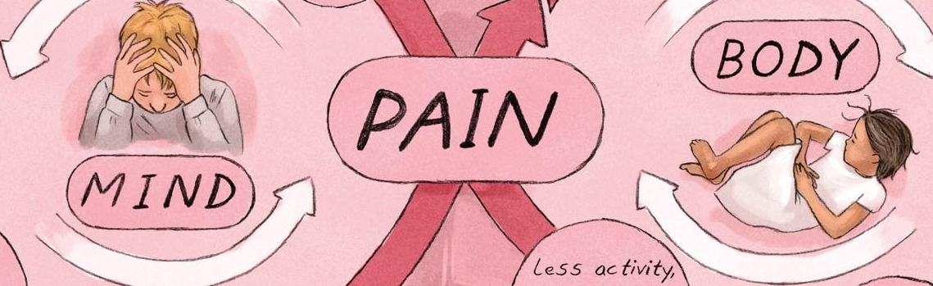
Understanding Acute and Chronic Pain in Physiotherapy 21.10.2025
Dr. Bruno Sil dos Santos
Reader in Pharmaceutics | School of Human Sciences

Slide 2
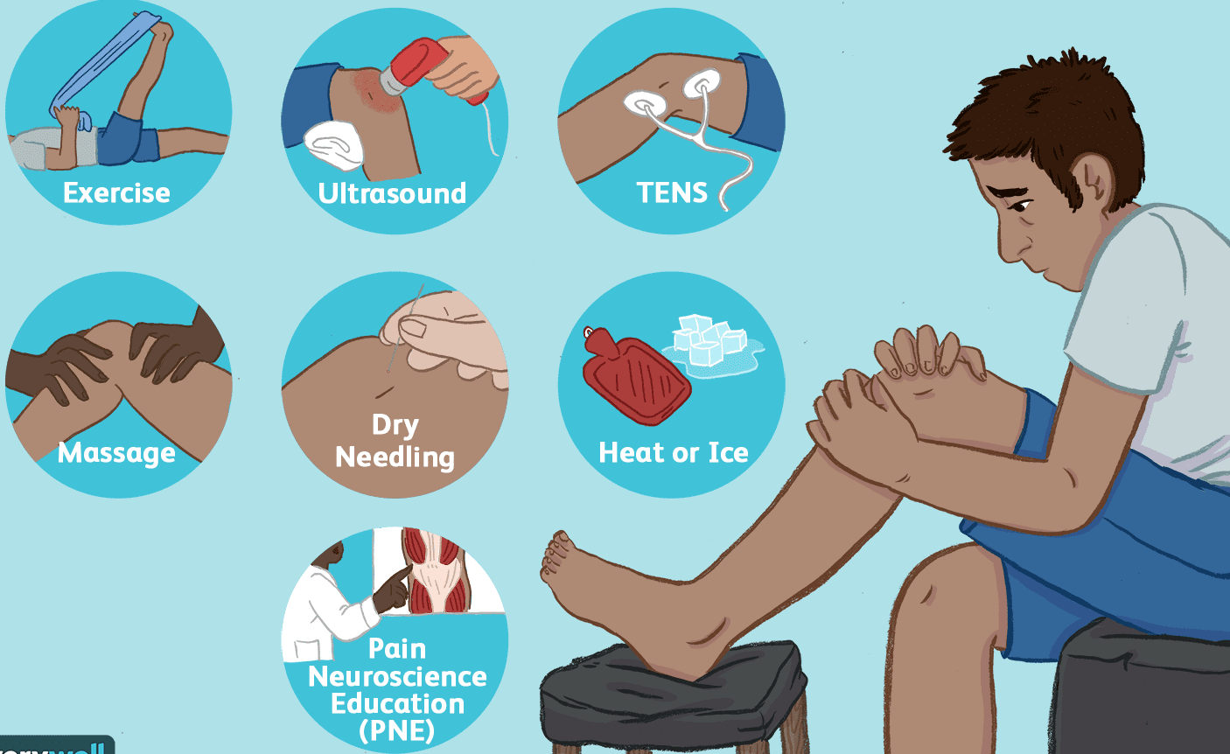
Understanding Acute and Chronic Pain for Physiotherapy Practice
ACP – PP – PA – CE – MS
Differentiate acute vs chronic pain.
Describe key neurophysiological pathways.
Apply pain scales in clinical settings.
Understand pharmacological and multidisciplinary approaches.

Slide 3
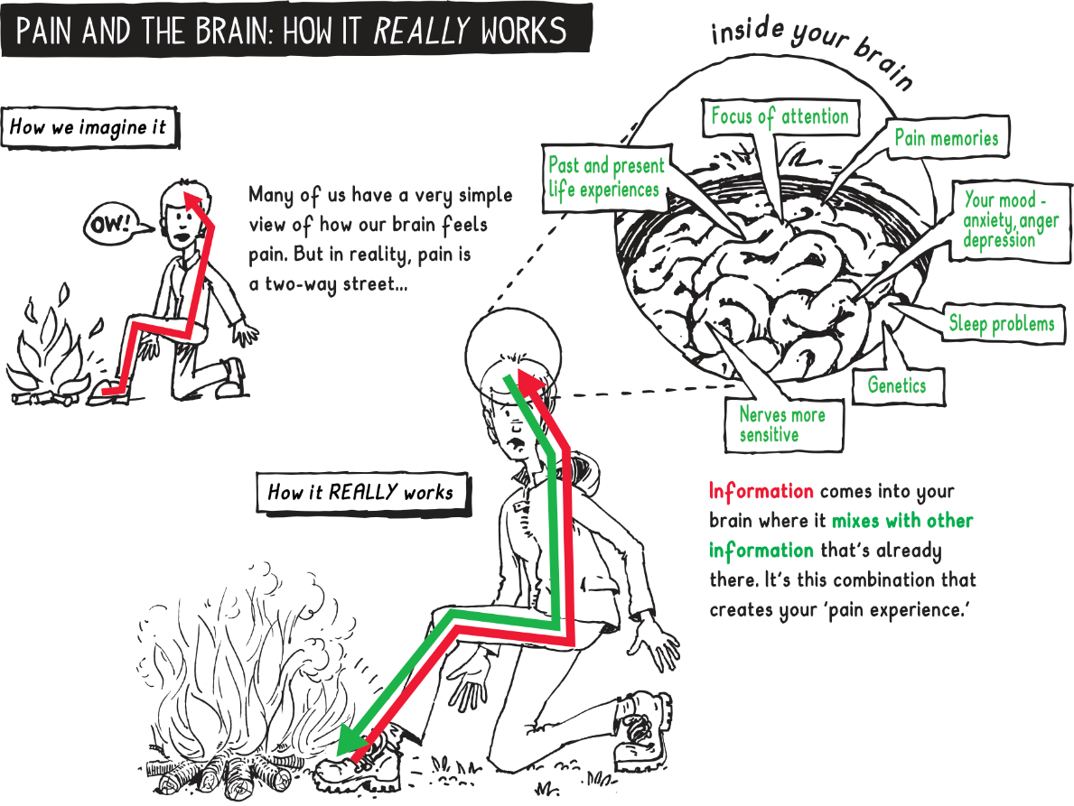
Pain Physiology (What Is Pain?)
ACP – PP – PA – CE – MS
Pain is “an unpleasant sensory and emotional experience associated with actual or potential tissue damage.” IASP (International Association for the Study of Pain).
It’s not just about tissue damage: biopsychosocial nature of pain.

Slide 4
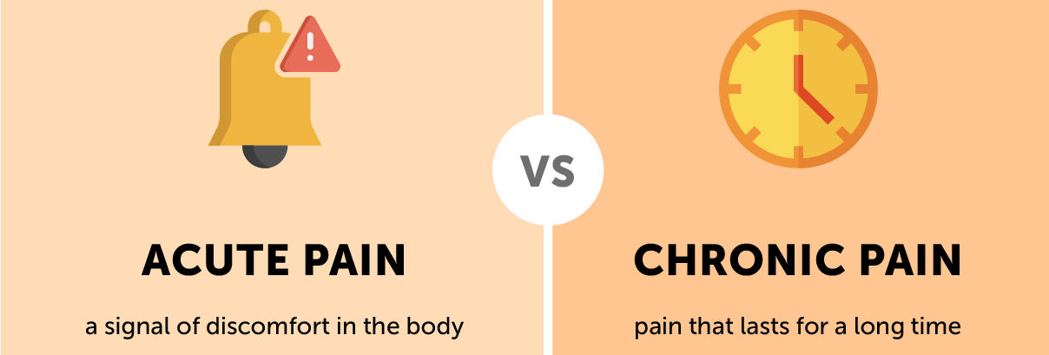
ACP – PP – PA – CE – MS
Pain Physiology (Acute vs Chronic Pain)
Type | Duration | Cause | Features | Goal of Treatment
Acute | <3 months | Injury/surgery | Sharp, protective | Resolution/healing
Chronic | >3 months | Often multifactorial | Persistent, maladaptive | Function & quality of life

Slide 5
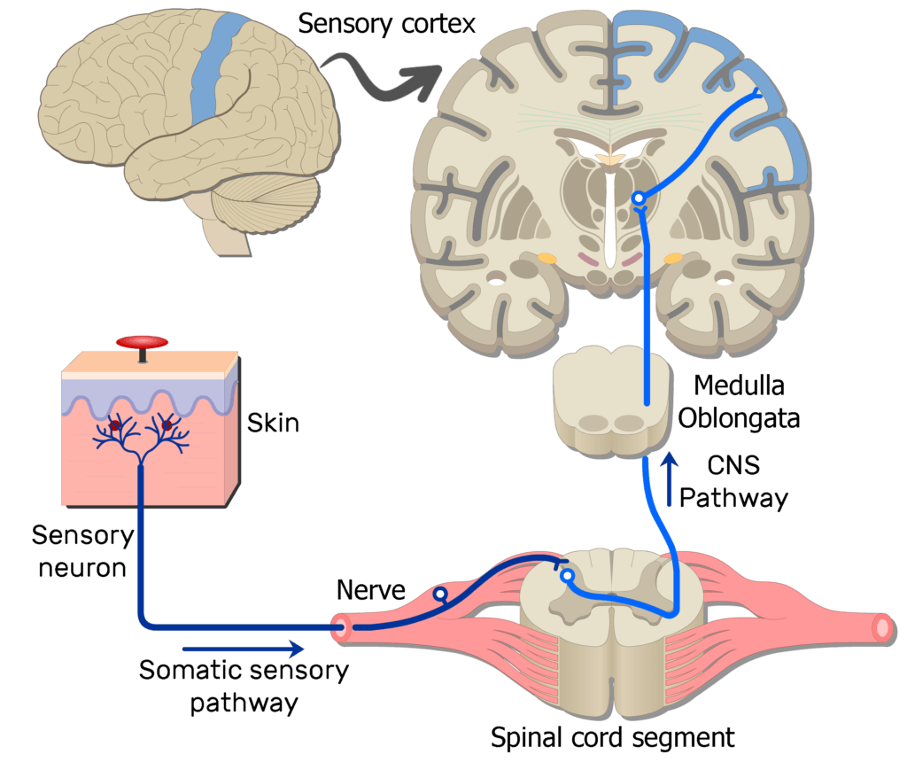
ACP – PP – PA – CE – MS
Pain Physiology (Nociceptive Pathway)
Stimulus → Nociceptor → Aδ/C fibres → Dorsal horn → Spinothalamic tract → Brain
Key regions: Thalamus, Somatosensory cortex, Limbic system
Notes:
Aδ (A-delta) fibers and C-fibers are types of nerve fibers responsible for transmitting sensory information, particularly pain, temperature, and itch, to the brain and spinal cord.

Slide 6
ACP – PP – PA – CE – MS
Pain Physiology (Types of Nociceptors)
Mechanical
Stimulus: Respond to intense mechanical stimuli, such as pinching, cutting, or stretching.
Examples: Respond to pressure or incisions that break the skin.
Thermal
Stimulus: Respond to extreme temperatures, either very hot or very cold.
Examples: Detect harmful heat or cold.
Chemical
Stimulus: Respond to chemical substances.
Examples: Substances that can act on body tissues, such as inflammatory mediators.
Polymodal
Stimulus: Respond to high-intensity mechanical, thermal, and/or chemical stimuli.

Slide 7
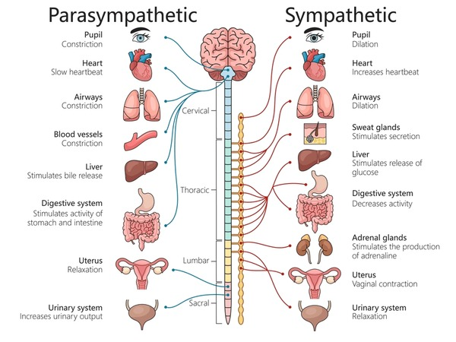
Autonomic Nervous System (ANS) in Pain
ACP – PP – PA – CE – MS
Sympathetic activation: ↑ HR, BP, sweating
Chronic pain: ANS dysregulation (e.g., fibromyalgia)

Slide 8
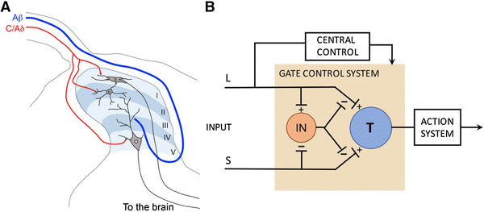
Gate Control Theory
ACP – PP – PA – CE – MS
Pain signals modulated at spinal cord “gate”.
Non-painful input can inhibit pain.
Basis for TENS (Transcutaneous Electrical Nerve Stimulation) and manual therapy.
Gate Closing: This activation of the inhibitory interneurons by Aβ fibers effectively "closes the gate," reducing the perception of pain.
Notes:
A diagram of the spinal cord's pain-gating mechanism shows large-diameter A-beta (Aβ) fibers (carrying touch/pressure) activating inhibitory interneurons, which then block pain signals from small-diameter A-delta (Aδ) and C fibers from reaching the brain's transmission neurons. Conversely, strong pain signals from Aδ and C fibers can inhibit these interneurons, allowing more pain signals to pass through the gate. This process, known as gate control theory, is why rubbing a painful spot can provide relief by activating Aβ fibers to "close the gate" to pain.

Slide 9
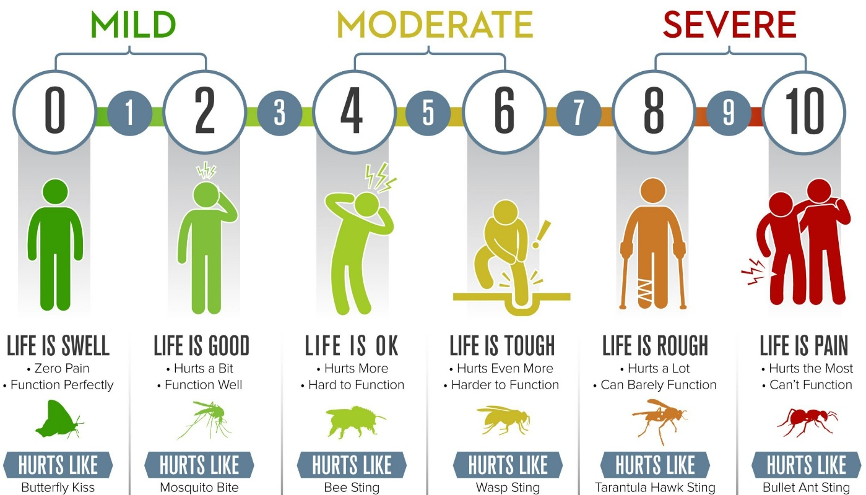
Pain Assessment
ACP – PP – PA – CE – MS
Guides treatment
Tracks progress
Enhances communication
Validates patient experience

Slide 10
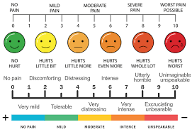
Visual Analogue Scale (VAS)
ACP – PP – PA – CE – MS
Content:
  0–10 cm line
  Patient marks pain intensity
  Simple, quick, subjective

Slide 11
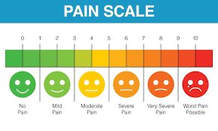
Numeric Rating Scale (NRS)
ACP – PP – PA – CE – MS
Content:
  Verbal 0–10 scale
  Easy to administer
  Common in acute settings

Slide 12
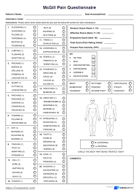
McGill Pain Questionnaire
ACP – PP – PA – CE – MS
Content:
  Descriptive words: sensory, affective, evaluative
  Captures pain quality
  Useful in chronic pain

Slide 13
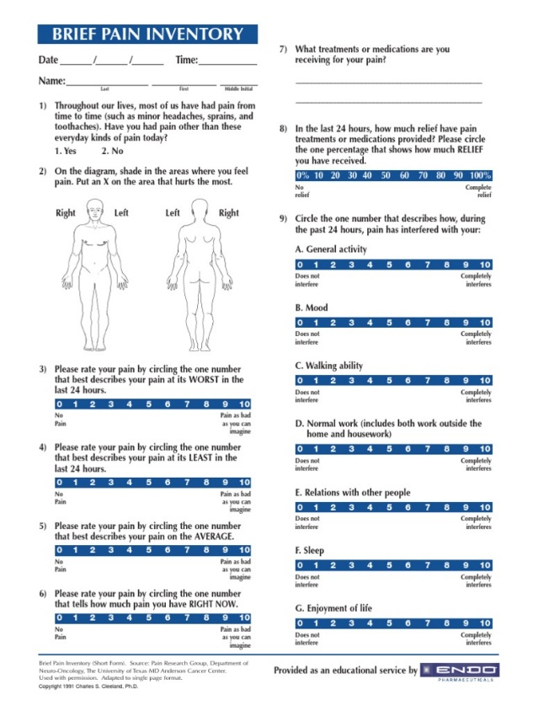
Brief Pain Inventory (BPI)
ACP – PP – PA – CE – MS
Content:
  Assesses pain severity and interference
  Domains: mood, sleep, activity
  Used in oncology and chronic pain

Slide 14
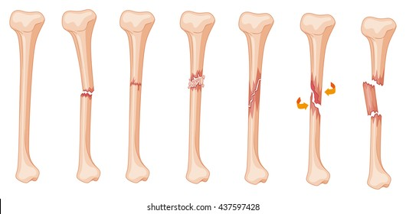
Clinical Examples (Fracture)
ACP – PP – PA – CE – MS
  Acute nociceptive pain
  Sharp, localised
  Responds to immobilisation and analgesia

Slide 15
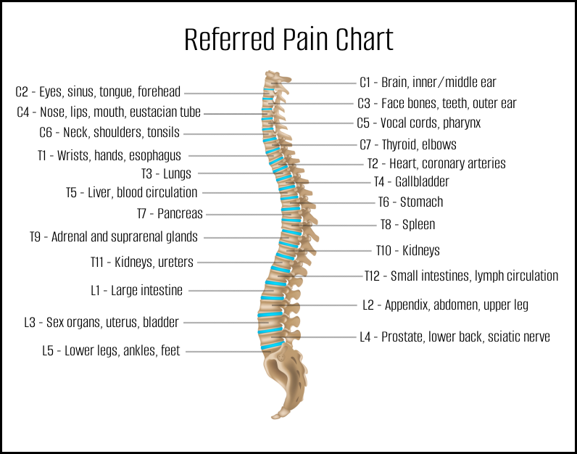
ACP – PP – PA – CE – MS
Clinical Examples (Back Pain)
  Can be acute or chronic
  Mechanical, neuropathic, or sensitised
  Requires thorough assessment

Slide 16
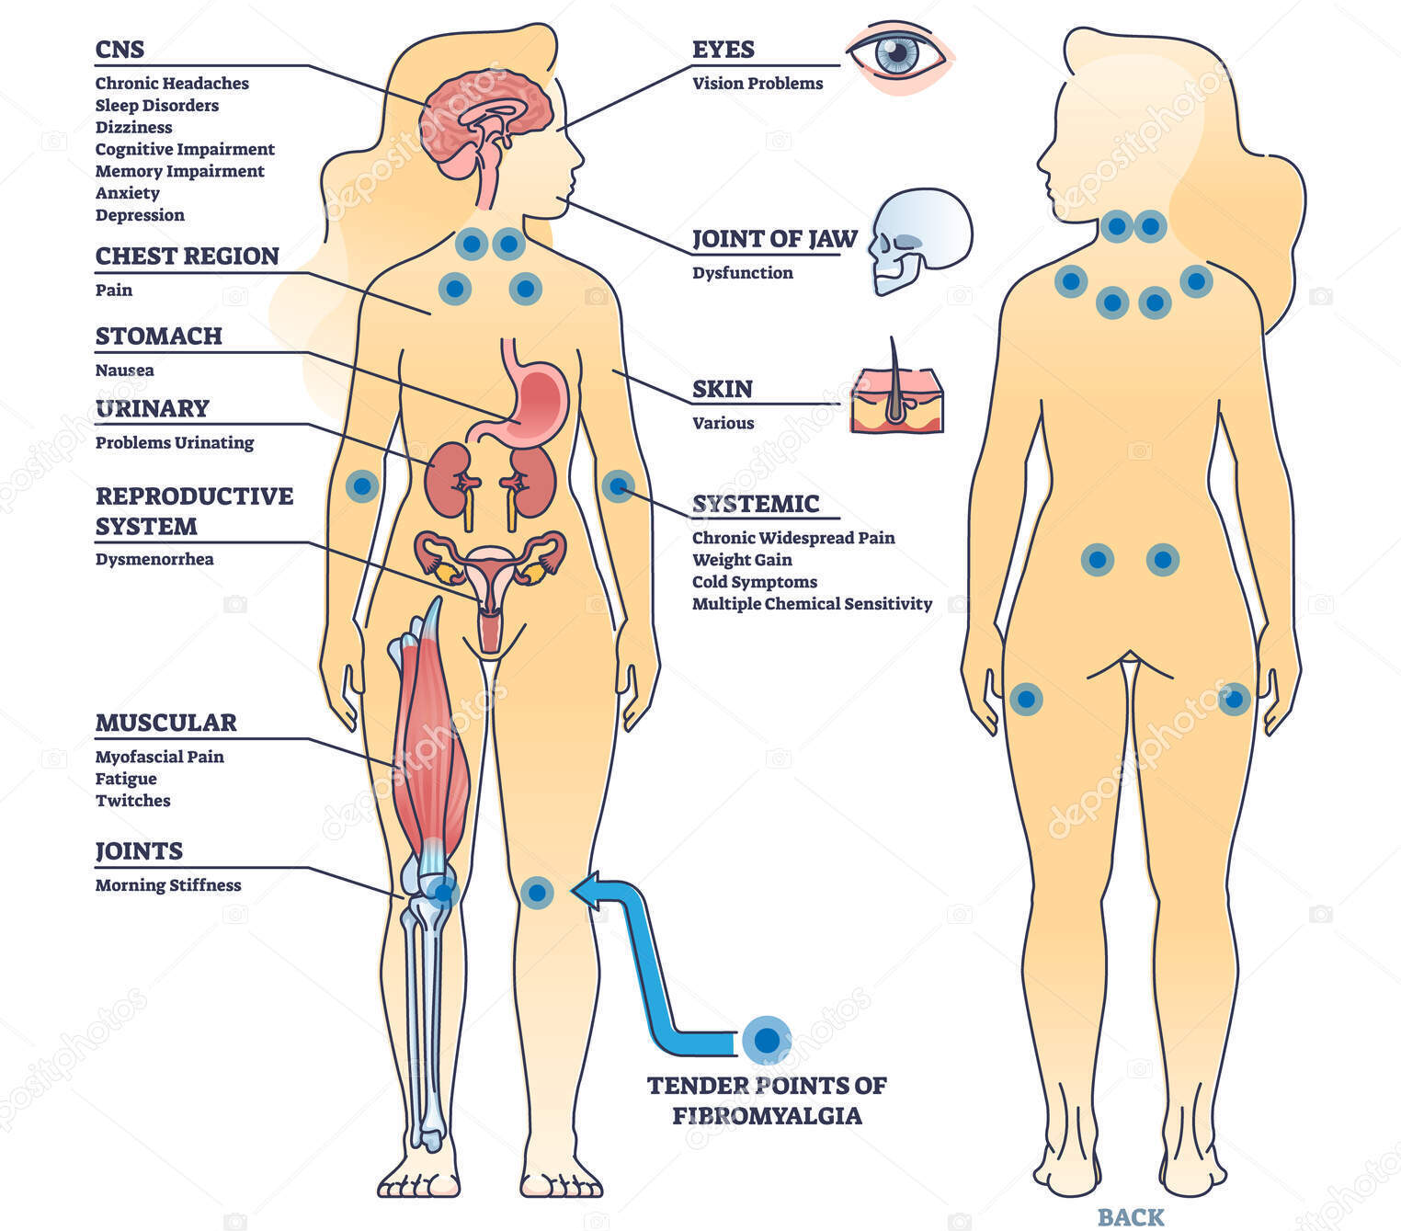
ACP – PP – PA – CE – MS
Clinical Examples (Fibromyalgia)
  Chronic widespread pain
  Central sensitisation
  Fatigue, sleep disturbance, cognitive symptoms
Notes:
Fibromyalgia is a chronic condition causing widespread, long-term pain throughout the body, accompanied by fatigue, non-refreshing sleep, and problems with memory and concentration. While there's no known cure, treatments focus on managing symptoms through medication, exercise, stress reduction, and self-care strategies to improve the quality of life.
Tender points are specific, small areas of the body that are highly sensitive to pressure, causing pain when a doctor presses on them during a physical exam. These points, located on both sides of the body in predictable patterns, are more common with conditions like fibromyalgia and can be a symptom of the widespread muscle pain associated with it. While previously used to diagnose fibromyalgia, other criteria are now preferred, though tender points remain a recognizable symptom.

Slide 17
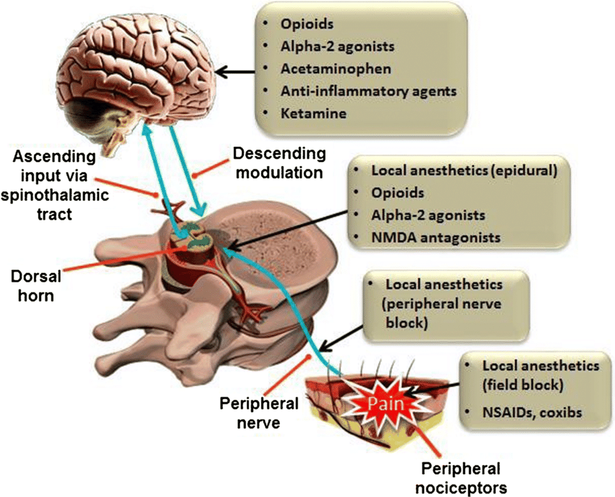
ACP – PP – PA – CE – MS
Clinical Examples (Post-Surgical Pain)
  Acute pain expected
  Risk of chronic pain if poorly managed
  Multimodal analgesia essential

Slide 18
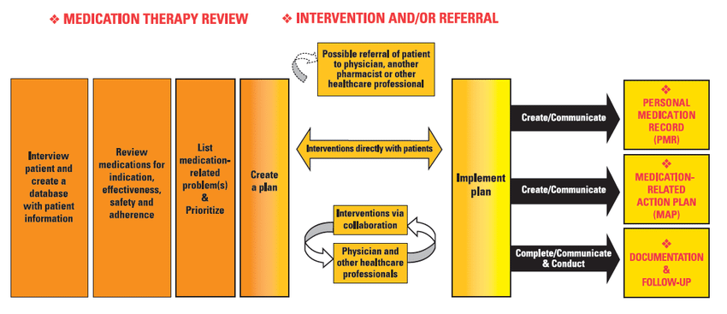
Management Strategies (Pharmacological Management)
ACP – PP – PA – CE – MS
Step | Medication Type | Example
1 | Non-opioid analgesics | Paracetamol, NSAIDs
2 | Adjuvants | Antidepressants, anticonvulsants
3 | Opioids (short-term) | Morphine, tramadol
4 | Topicals | Capsaicin, lidocaine

Slide 19
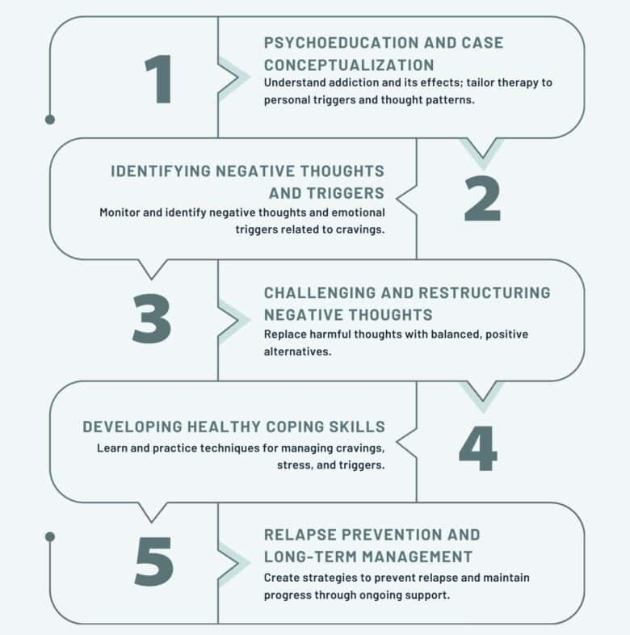
Management Strategies (Non-Pharmacological Approaches)
ACP – PP – PA – CE – MS
  Manual therapy (no machine usage)
  Exercise therapy (massage, hydrotherapy)
  TENS (Transcutaneous electrical nerve stimulation)
  Education
  CBT (Cognitive Behavioural Therapy)
  (Physiotherapy’s central role in pain modulation)

Slide 20
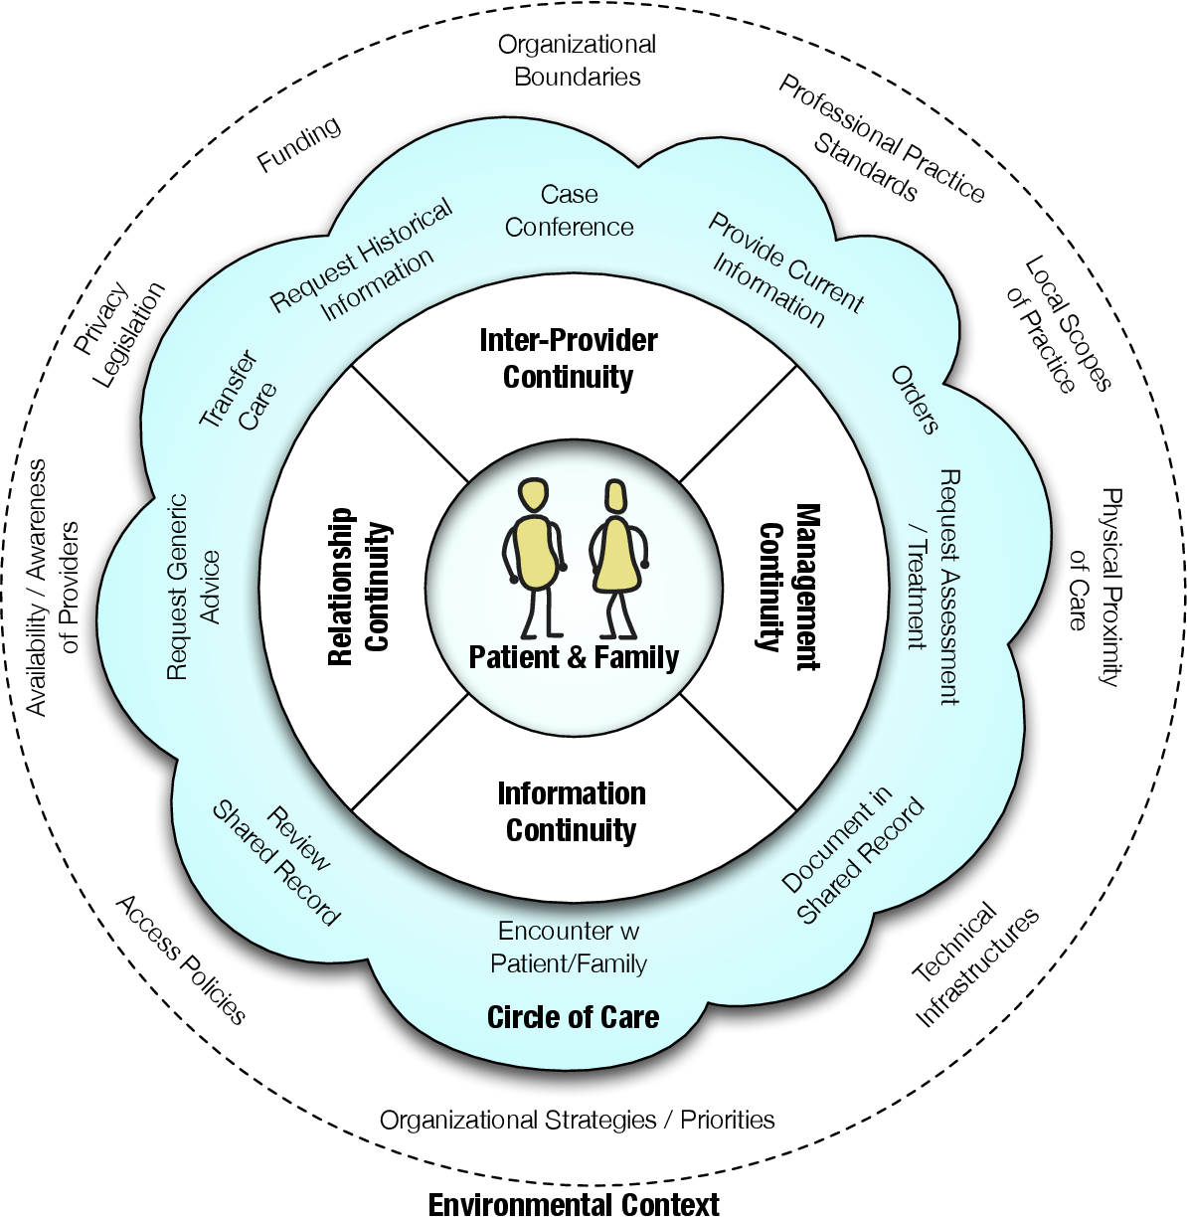
Management Strategies (Multidisciplinary Pain Management)
ACP – PP – PA – CE – MS
  Physiotherapy
  Psychology
  Medicine
  Occupational therapy
  Social support

Slide 21

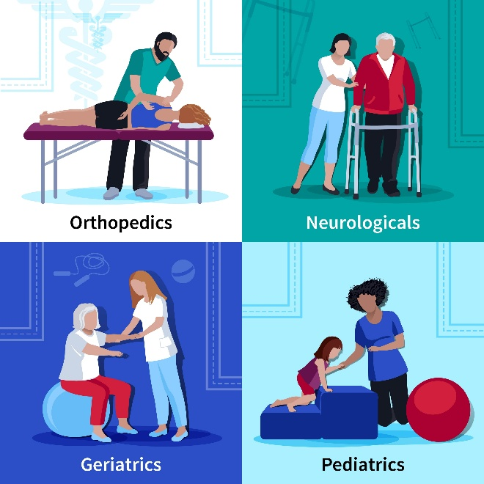
Summary
ACP – PP – PA – CE – MS
Pain is complex and multifactorial
Assessment tools guide care
Management must be individualised
Physiotherapists play a key role
Acute ≠ Chronic
Use validated pain scales
Understand neurophysiology
Collaborate across disciplines

